Slide 1
AMM - EV Power Optimization
Guidelines/Attributes to increase travel range for fixed battery
Hyundai Mobis
Chandra Sekhar Chitikela and Pradeep Kumar K (chandrashekhar.chitikela@gmobis.com, pradeepkumar.k@gmobis.com)
April 2023
COVESA Wiki Link for EV Power Optimization Project: https://wiki.covesa.global/display/WIK4/EV+Optimization+-+Increase+Travel+Range+for+Fixed+Battery

Slide 2
AGENDA/OBJECTIVE
Why?
Need to understand the importance of Power optimization during critical SOC stage
Backup the travel range effecting parameters data on cloud
Where?
Appliance of backup data in crisis situations like running out of battery
Goal - To minimize/avoid last mile anxiety
Support OEMs to analyze and derive power efficient algorithms
Goal – Better battery management by run time optimization
What?
Seek Collaboration from the industry players

Slide 3

parameters effecting Travel range
Power Train
Drive Motor
Chassis
Steering
Brake
Electronic System
Lighting
Suspension
chassis
Battery Pack
Diagnostics
Networking
CAN
LIN
FlexRay
MOST
Bluetooth
Wi-Fi
Safety and Control
Airbag
TPMS
Collision Warning
PAS
Rear monitor
Night Vision
Infotainment
Comfort and Control
Power Window
Seat Control
Power door
Mirrors/Wiper control
HVAC
GPS/Navigation
Entertainment
Connectivity
Car Audio
Dashboard
Range Calculations:
External:
Drivers Behavior, weight
Traffic, Weather
Charge station infra.
Fixed Range

Slide 4
PRACTICAL USE-CASES
Driver Alert state:
SOC
100%
SOC
50%
SOC
20%
SOC
0%
Fixed Range
Power Train
(~60 to 80%)
Speed Limit
Eco Drive ON
Range Impact
~10 to 20%
IVI
(~1to 2 %)
Brightness Control
Audio control
Range Impact
~0.2 to 0.5%
HVAC
(~10 to 15%)
Fan Control
Ambient Temp. Control
Range Impact
~5 to 10%
Lighting
(~ 2 to 5 %)
Light intensity control
Range Impact
~2 to 5%
Steering, Windows & Sunroof
(~3 to 8%)
Speed Control
On/off control
Range Impact
~2 to 5%
Others(ADAS, Sensors, Cameras etc.)
(~1 to 5 %)
On/off or partial control
Range Impact
~2 to 5%
+Power Saving Policy
Extended Range
Power Distribution
Optimization Policy
Extra Range

Slide 5
Practical/Simulation Results

Slide 6
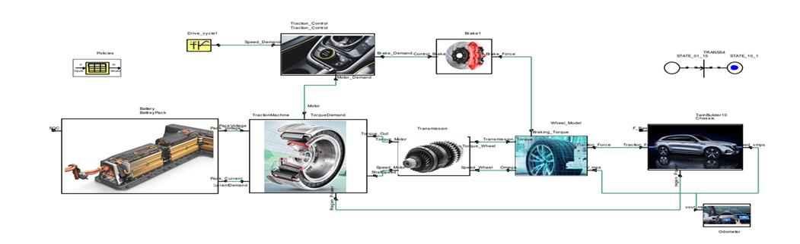


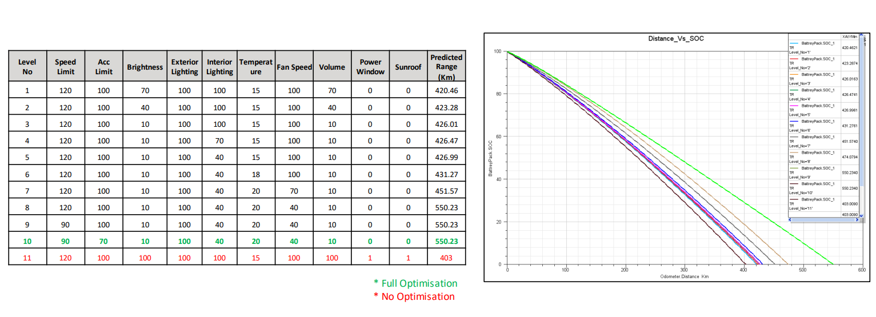
SIMULATION RESULT: optimization policies Vs Power Savings
Vehicle Model Considered | xxx
Maximum Range | 248 Miles/~400 Km
Battery Size/Capacity | ~80 Kwh
Energy Consumed (Wh/mi) | 322 Wh/mi
Optimization policy | Level 1/……………Level 10
Ansys model proves that designed model with sample defined optimization policies on various subsystems (including IVI, HVAC, Lighting and motor drive) the possible range extension by 5% to ~30%%

Slide 7
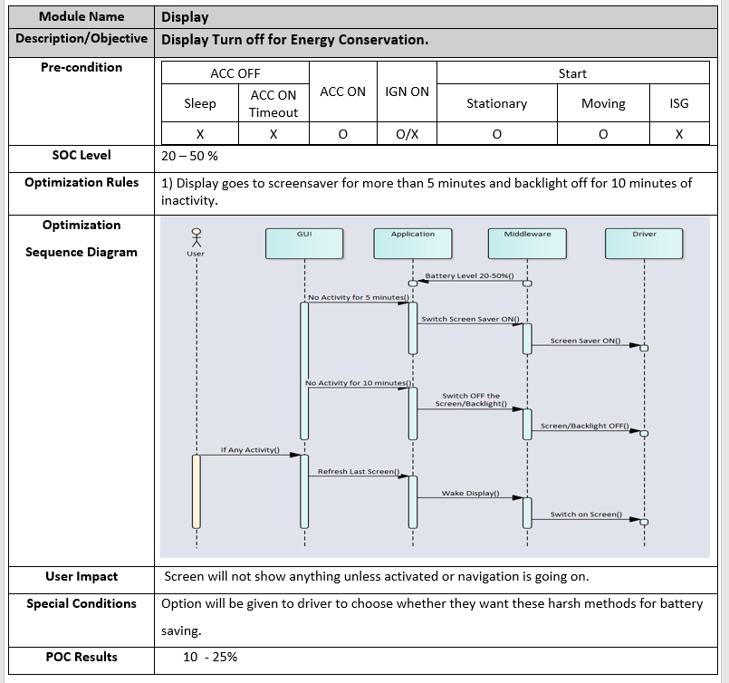
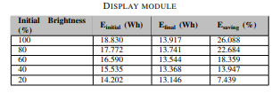
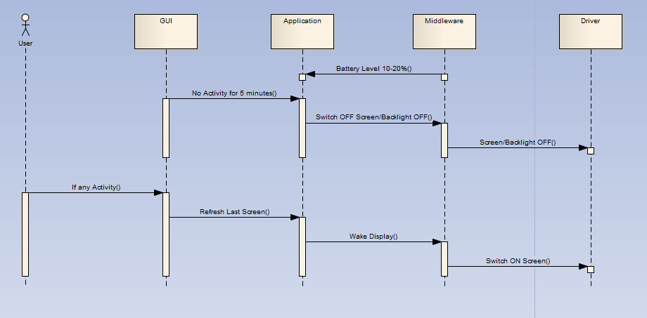
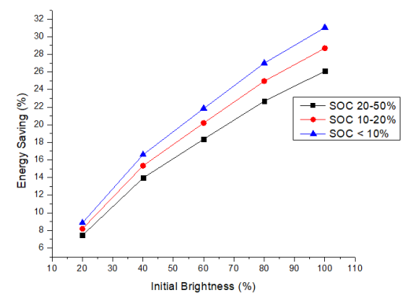
IVI Use Cases : poc result - Display(8” TFT) Power Optimization
Observation: At high display brightness, if optimization is applied to minimize brightness, then maximum power savings achieved

Slide 8
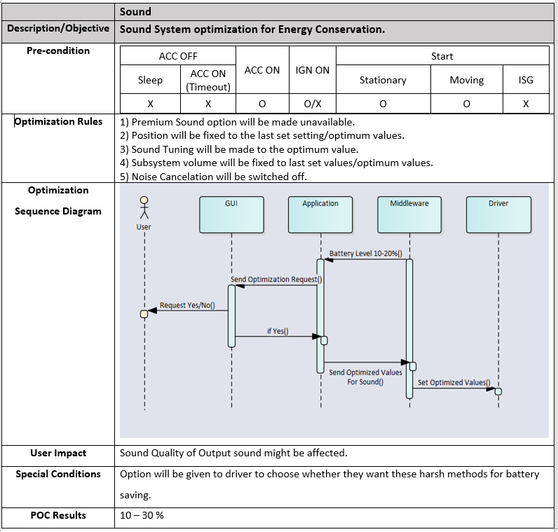
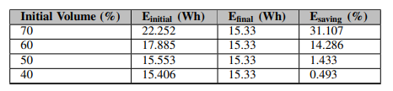
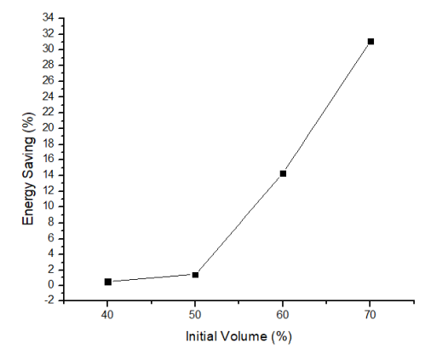
IVI Use Cases :POC result-SOUND Level Power Optimization
Observation: At high volume, if optimization is applied to minimize volume, then maximum power savings achieved

Slide 9
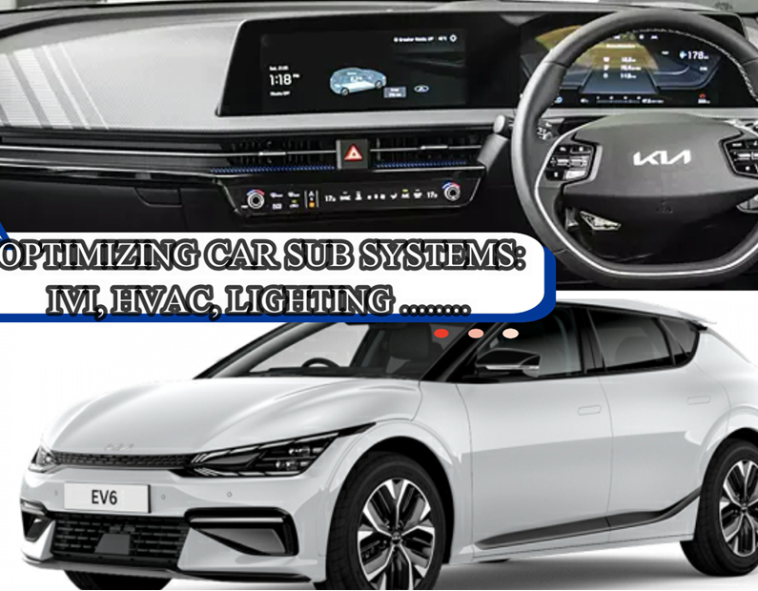
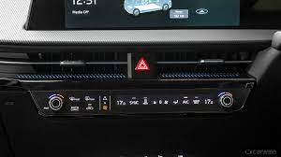
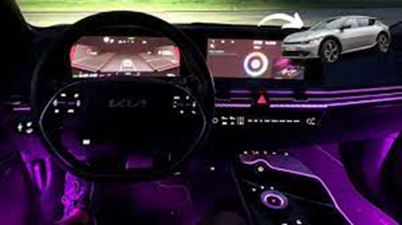
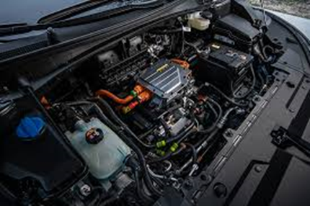
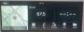
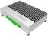
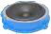
MOBIS EV POWER OPTIMIZER – IVI APPLICATION
Objectives
Avoid last mile anxiety
Efficient battery utilization
Runtime aggressive power management
Approach
Car sub system optimization by IVI controlled interfaces & Signals
Pre-Defined policies can be provided as user selection options and auto optimization
IVI
HVAC
Cabin Lighting
E.Drive
Display
Sound system
Power Optimization policy Policy
Mobis Optimizer proto Application Developed on EV6
Auto & Level 1 to Level 4 Optimization selection at run time
Level 5 to Level 10 towards aggressive optimization

Slide 10
EV Power Optimization in VSS
Integration of EV Power optimization signals in VSS

Slide 11
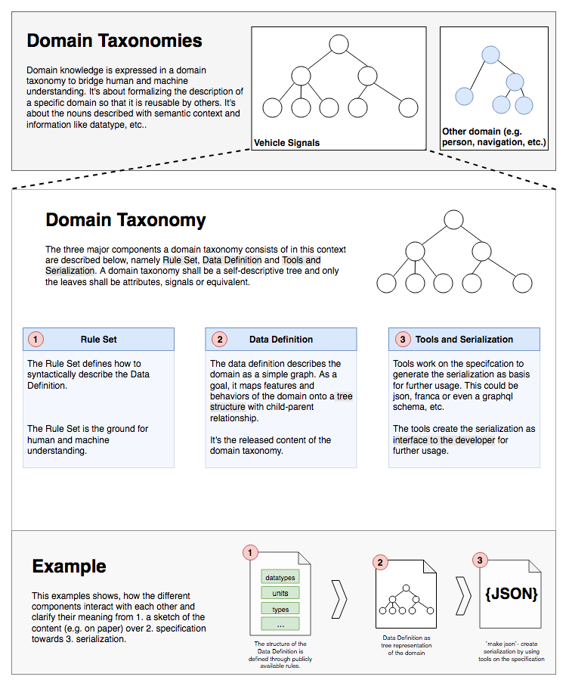
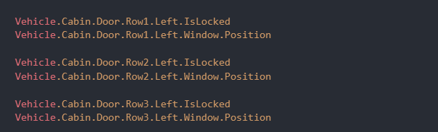
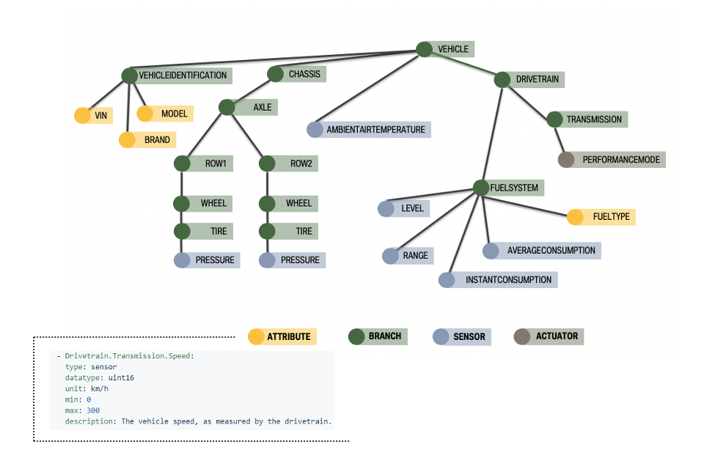
VSS in brief - https://wiki.covesa.global/display/WIK4/VSS+-+Vehicle+Signal+Specification
What is VSS
Vehicle Signal Specification
- Domain taxonomy/Catalogue for vehicle signals.
Rule Set
Parent node – Vehicle model
Branches - Vehicle main sub systems
Modules - Subsystem components
Signals – In the form of sensor, Actuators and meta data(new)
Data Definition
Define data model of each module in terms of signals
Categorize the signal based input and out forms
Identify data types for each signal
Define the acceptable range of signals
Tools to Develop & Serialize
Define interfaces for each signal
Implement and push to(using GitHub) local branch for review(by VSS team during weekly meet)
Make pull request to integrate with main branch code

Slide 12
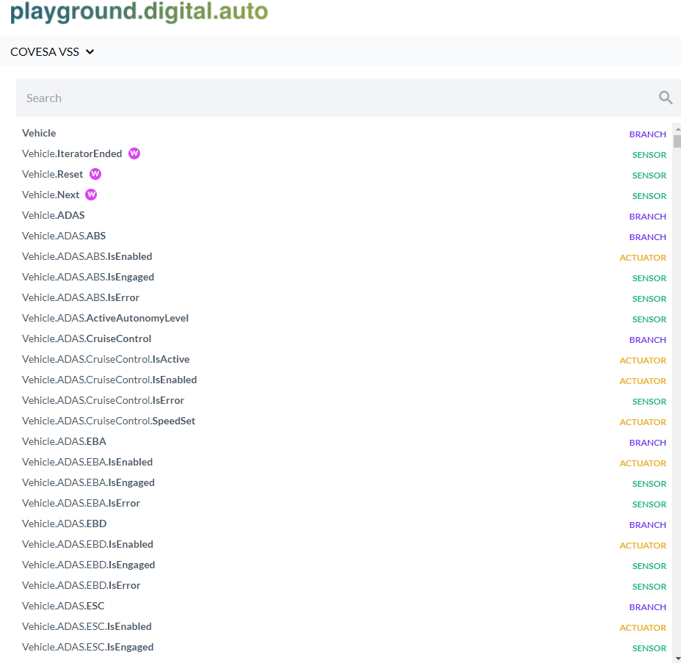
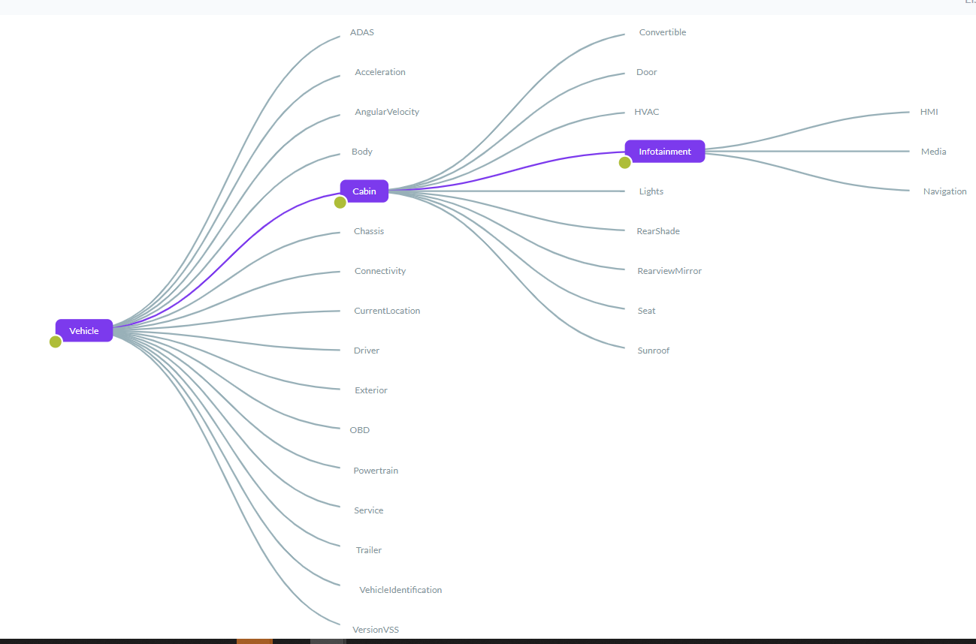
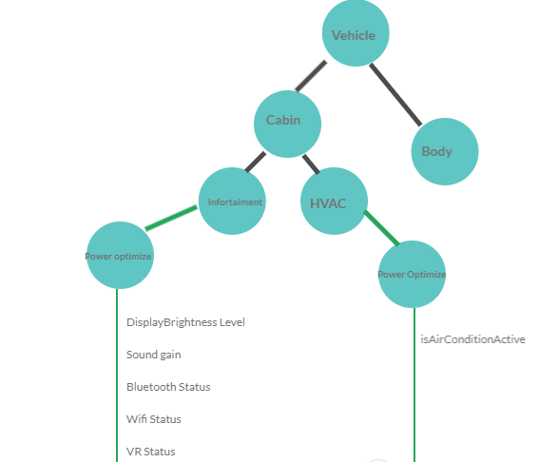
VSS through DIGITALAUTO playground - https://digitalauto.netlify.app/model
VSS List View
VSS Tree View
EV Power Optimization branch addition to VSS

Slide 13
APPROACH IN TRACKING TRAVEL RANGE ATTRIBUTES
Approach 1
Approach 2
vehicle
vehicle
PowerOptimize
Cabin
Body
Cabin
Cabin
Body
Infotainment
Infotainment
HVAC
HVAC
PowerOptimize
PowerOptimize
HMI
Media
HMI
Media
New Signals
Vehicle.PowerOptimze | Infotainment | DisplayBrightnessLevel
 |  | Sound/SpekareGain
 |  | BluetoothStatus
 |  | Wi-Fi Status
 |  | AA/CP Status
 |  | VRStatus
Vehicle.PowerOptimze | HVAC | Compressor Status

Slide 14
Project Scope
In scope
Primary focus on comfort features like vehicle->cabin Infotainment, HVAC, Lights, Sunroof etc
Define standard guidelines with proven scenarios and electrical power analysis
Define standard signals which can assist in deriving the optimization algorithms by OEM’s
Extended Scope
Can be considered other vehicle modules like Body, ADAS etc. to define signals
Assumptions
POC of identified scenarios/use cases shall be performed by module owned team and results shall be published along with guideline document
Schedules
Publish in
COVESA
Present in
AMM
Kick of
project
Develop
Guidelines
(Infotainment)
Develop
Signals
(Infotainment)
Github Commit
(Infotainment)
Develop
Guidelines
(HVAC)
Develop
Signals
(HVAC)
Github Commit
(HVAC)
---- Lights
‘22.09
’22.10
’22.11
’22.12
’23.01
’23.02
’23.07
’23.10
’23.12
Phase 1
Phase 2
Phase 3

Slide 15
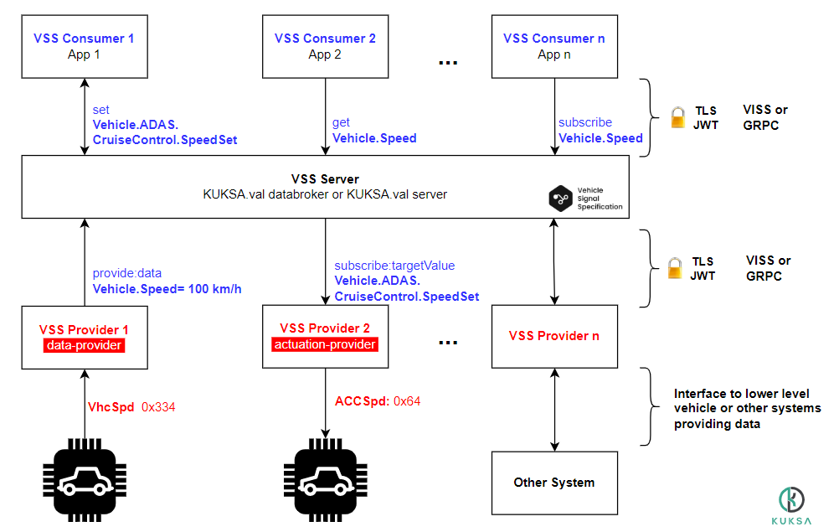
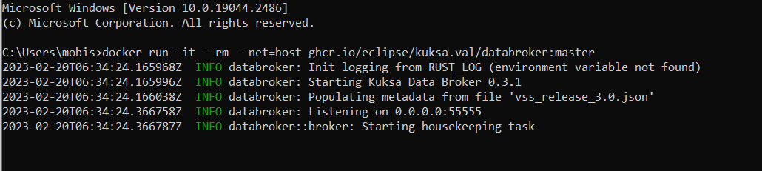
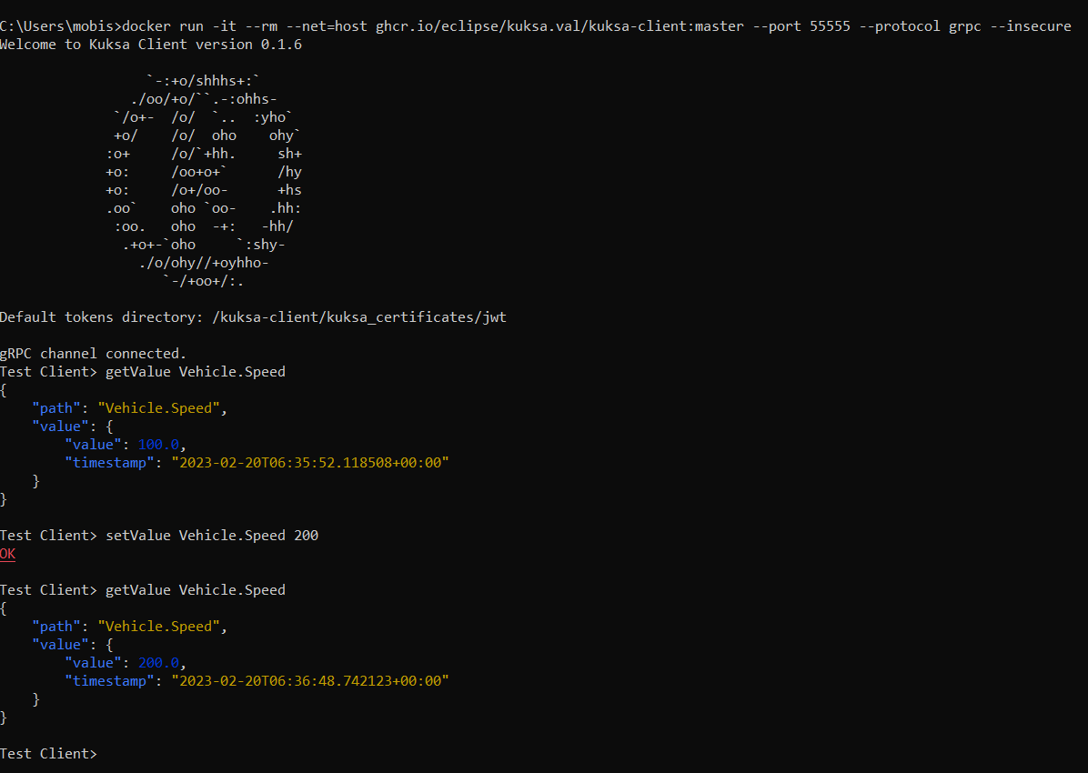
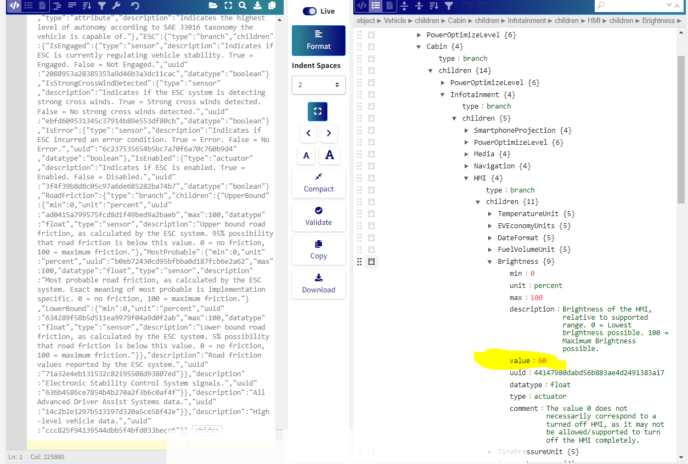
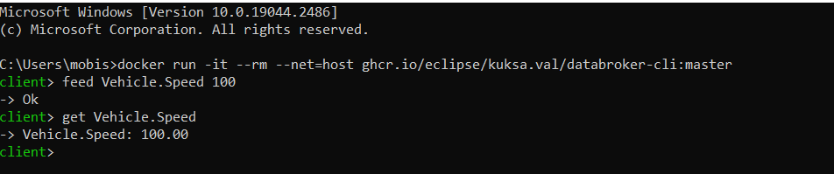
KUKSA system architecture
Running databroker service
Get and set value from VSS Server in Json format
Feed and get value from VSS Server

Slide 16
COVESA Wiki Link: https://wiki.covesa.global/display/WIK4/EV+Optimization+-+Increase+Travel+Range+for+Fixed+Battery
chandrasekhar.chitikela@gmobis.com
pradeepkumar.k@gmobis.com

